Slide 1


A (Fire)Cloud-Based DNA Methylation Data Preprocessing and Quality Control Platform
Divy Kangeyan
http://aryee.mgh.harvard.edu/dna-methylation-tools/

Slide 2

FireCloud
An open platform for secure and scalable analysis on the cloud
http://aryee.mgh.harvard.edu/dna-methylation-tools/

Slide 3




Tenets of data analysis platform
Scalability
Reproducibility
Best practice
analysis pipelines
Access to publicly available datasets
http://aryee.mgh.harvard.edu/dna-methylation-tools/

Slide 4
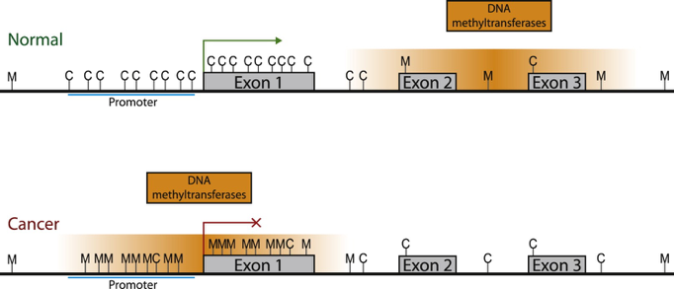
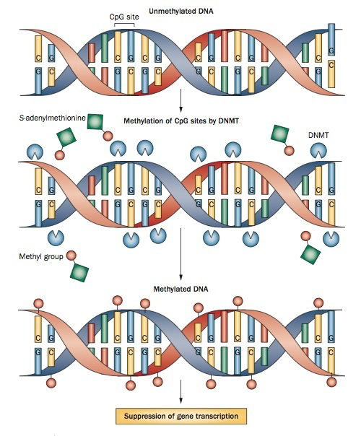
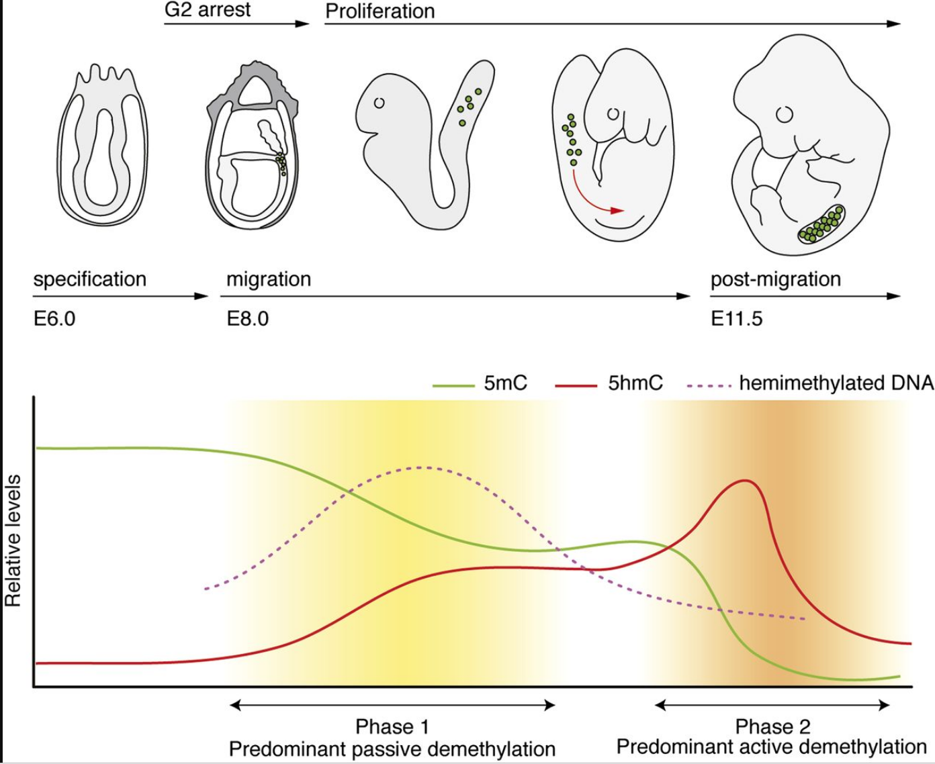
DNA Methylation & Implications
Tumorigenesis
Embryo Development
http://aryee.mgh.harvard.edu/dna-methylation-tools/

Slide 5
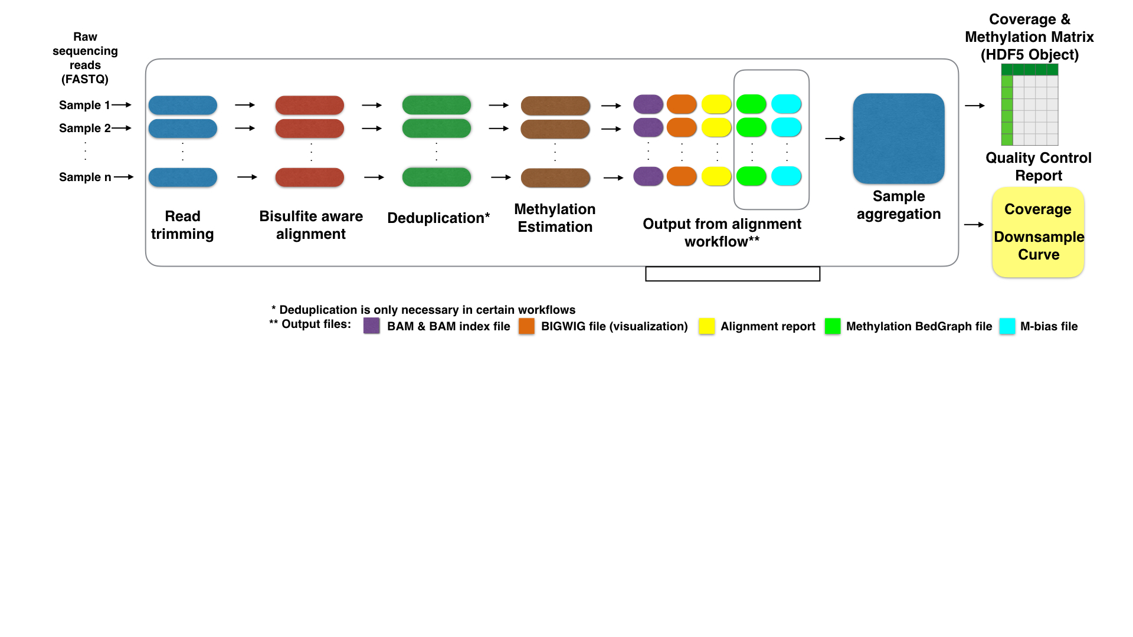
Methylation analysis platform
http://aryee.mgh.harvard.edu/dna-methylation-tools/

Slide 6
Tools
R and scmeth package in Bioconductor is used for aggregation and QC analysis
WDL (Workflow Development Language) glues all the tools together
http://aryee.mgh.harvard.edu/dna-methylation-tools/

Slide 7
QC Metrics
Read Coverage
CpG Coverage
http://aryee.mgh.harvard.edu/dna-methylation-tools/

Slide 8
QC Metrics
CpG Density plot
M-bias plot
http://aryee.mgh.harvard.edu/dna-methylation-tools/

Slide 9
Summary
FireCloud based methylation pipelines provide scalable and reproducible way to conduct methylation data preprocessing
QC analysis optimized for large sample sizes, i.e. single-cell datasets
QC analysis in the pipeline provides users with better insights on conducting further downstream analysis

